Slide 1

Introduction to CUDA (4) Memory And Data Locality
Parallel Computing

Slide 2
Content
Importance of Memory Access Efficiency
--Matrix Multiplication
Memory Types Overview
Tiling for reduced memory traffic
--Matrix Multiplication using Shared Memory

Slide 3
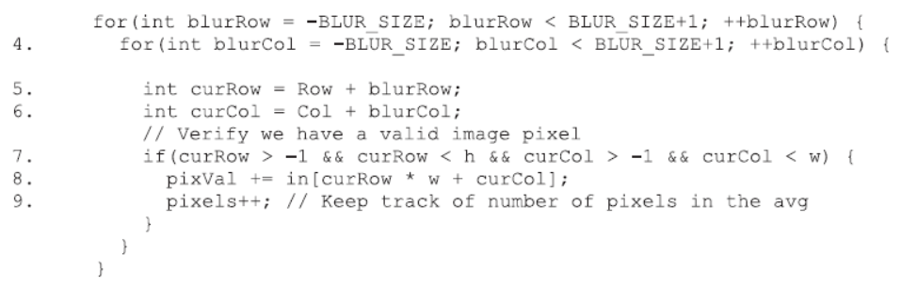
Importance of Memory Access Efficiency
image blurring kernel中最耗时语句
如何评估内存访问效率：
Compute-to-global-memory-access Ratio

Slide 4
Importance of Memory Access Efficiency
image blurring kernel中最耗时语句
Compute-to-global-memory-access Ratio:
假设全局内存带宽为1TB/s，每个单精度浮点值占用4字节，因此每秒最多只能加载1000/4 = 250G单精度操作。
如果 Compute-to-global-memory-access ratio 值为1, 则最多只能达到250GFLOPS，仅为设备计算能力（12TFLOPS）的2%。.
Compute-to-global-memory-access ratio需要提高到48或更高.

Slide 5
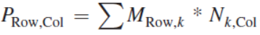
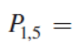
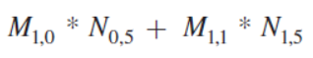
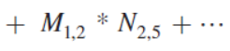
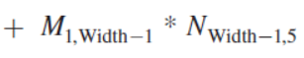
Matrix Multiplication Example
N
k
j
WIDTH
M
P
i
WIDTH
k
WIDTH
WIDTH
Notes:
Point out that I and j will become global thread indices.

Slide 6
Matrix Multiplication Example
// Matrix multiplication on the (CPU) host in single precision
void MatrixMulOnHost(float* M, float* N, float* P, int Width)‏
{
for (int i = 0; i < Width; ++i)‏
for (int j = 0; j < Width; ++j) {
float sum = 0;
for (int k = 0; k < Width; ++k) {
float a = M[i * Width + k];
float b = N[k * Width + j];
sum += a * b;
}
P[i * Width + j] = sum;
}
}
N
k
j
WIDTH
M
P
i
A Simple Host Version in C
WIDTH
k
WIDTH
WIDTH
Notes:
Point out that I and j will become global thread indices.

Slide 7
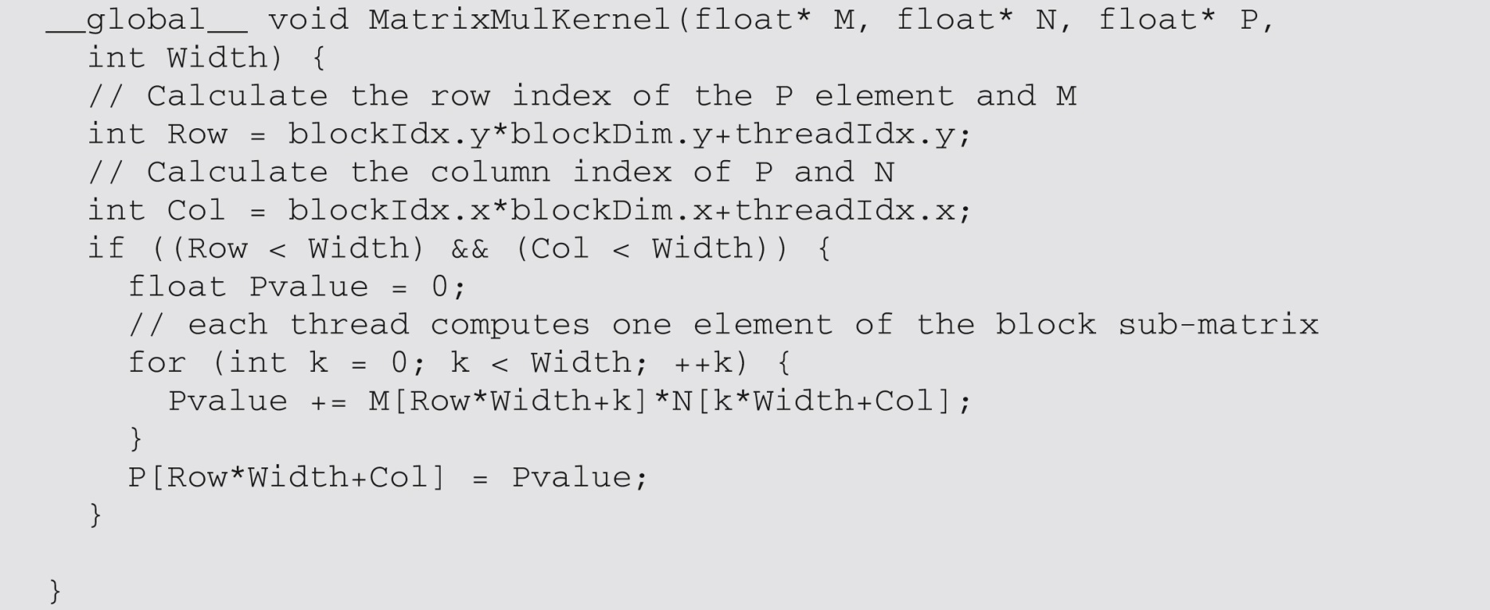
Initial matrix multiplication version
一个简单的矩阵乘法kernel：
——使用一个线程计算一个P元素。

Slide 8
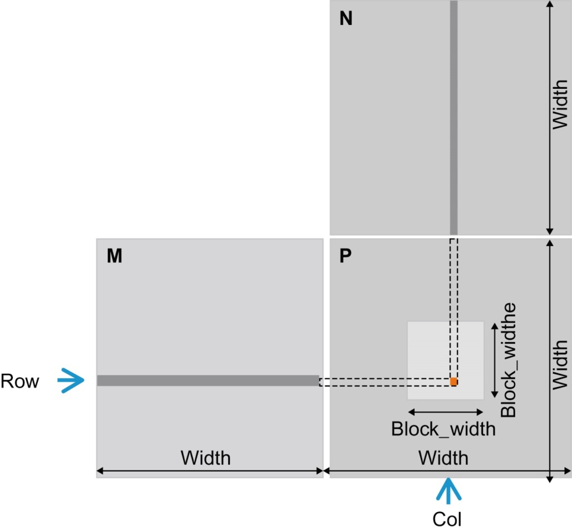
Initial matrix multiplication version
使用多个线程块进行矩阵乘法；
每个线程块负责一个矩阵子块。

Slide 9
Kernel Function - A Small Example
每个2D 线程 block 负责计算结果矩阵中的(TILE_WIDTH)² 子矩阵 (tile)
每个线程block包含 (TILE_WIDTH)² 线程
创建2D Grid，包含 (WIDTH/TILE_WIDTH)² 个blocks
Block(0,0)
Block(0,1)
P_{0,0}
P_{0,1}
P_{0,2}
P_{0,3}
WIDTH = 4; TILE_WIDTH = 2
Each block has 2*2 = 4 threads
P_{1,0}
P_{1,1}
P_{1,2}
P_{1,3}
P_{2,0}
P_{2,1}
P_{2,2}
P_{2,3}
WIDTH/TILE_WIDTH = 2
Use 2* 2 = 4 blocks
P_{3,0}
P_{3,1}
P_{2,3}
P_{3,3}
Block(1,0)
Block(1,1)

Slide 10
A Slightly Bigger Example
(TILE_WIDTH =2)
P_{0,0}
P_{0,1}
P_{0,2}
P_{0,3}
P_{0,4}
P_{0,5}
P_{0,6}
P_{0,7}
P_{1,0}
P_{1,1}
P_{1,2}
P_{1,3}
P_{1,4}
P_{1,5}
P_{1,6}
P_{1,7}
P_{2,0}
P_{2,1}
P_{2,2}
P_{2,3}
P_{2,4}
P_{2,5}
P_{2,6}
P_{2,7}
WIDTH = 8; TILE_WIDTH = 2
Each block has 2*2 = 4 threads
P_{3,0}
P_{3,1}
P_{3,2}
P_{3,3}
P_{3,4}
P_{3,5}
P_{3,6}
P_{3,7}
P_{4,0}
P_{4,1}
P_{4,2}
P_{4,3}
P_{4,4}
P_{4,5}
P_{4,6}
P_{4,7}
P_{5,0}
P_{5,1}
P_{5,2}
P_{5,3}
P_{5,4}
P_{5,5}
P_{5,6}
P_{5,7}
WIDTH/TILE_WIDTH = 4
Use 4* 4 = 16 blocks
P_{6,0}
P_{6,1}
P_{6,2}
P_{6,3}
P_{6,4}
P_{6,5}
P_{6,6}
P_{6,7}
P_{7,0}
P_{7,1}
P_{7,2}
P_{7,3}
P_{7,4}
P_{7,5}
P_{7,6}
P_{7,7}

Slide 11
A Slightly Bigger Example (cont.)
(TILE_WIDTH = 4)
P_{0,0}
P_{0,1}
P_{0,2}
P_{0,3}
P_{0,4}
P_{0,5}
P_{0,6}
P_{0,7}
P_{1,0}
P_{1,1}
P_{1,2}
P_{1,3}
P_{1,4}
P_{1,5}
P_{1,6}
P_{1,7}
P_{2,0}
P_{2,1}
P_{2,2}
P_{2,3}
P_{2,4}
P_{2,5}
P_{2,6}
P_{2,7}
WIDTH = 8; TILE_WIDTH = 4
Each block has 4*4 =16 threads
P_{3,0}
P_{3,1}
P_{3,2}
P_{3,3}
P_{3,4}
P_{3,5}
P_{3,6}
P_{3,7}
P_{4,0}
P_{4,1}
P_{4,2}
P_{4,3}
P_{4,4}
P_{4,5}
P_{4,6}
P_{4,7}
WIDTH/TILE_WIDTH = 2
Use 2* 2 = 4 blocks
P_{5,0}
P_{5,1}
P_{5,2}
P_{5,3}
P_{5,4}
P_{5,5}
P_{5,6}
P_{5,7}
P_{6,0}
P_{6,1}
P_{6,2}
P_{6,3}
P_{6,4}
P_{6,5}
P_{6,6}
P_{6,7}
P_{7,0}
P_{7,1}
P_{7,2}
P_{7,3}
P_{7,4}
P_{7,5}
P_{7,6}
P_{7,7}

Slide 12
Work for Block (0,0)
Col = 0
blockDim.x
blockDim.y
Col = 1
Col = 0 * 2 + threadIdx.x
Row = 0 * 2 + threadIdx.y
N_{0,0}
N_{0,1}
N_{0,2}
N_{0,3}
N_{1,0}
N_{1,1}
N_{1,2}
N_{1,3}
N_{2,0}
N_{2,1}
N_{2,2}
N_{2,3}
blockIdx.x
blockIdx.y
N_{3,0}
N_{3,1}
N_{3,2}
N_{3,3}
Row = 0
M_{0,0}
M_{0,1}
M_{0,2}
M_{0,3}
P_{0,0}
P_{0,1}
P_{0,2}
P_{0,3}
Row = 1
M_{1,0}
M_{1,1}
M_{1,2}
M_{1,3}
P_{1,0}
P_{1,1}
P_{1,2}
P_{1,3}
M_{2,0}
M_{2,1}
M_{2,2}
M_{2,3}
P_{2,0}
P_{2,1}
P_{2,2}
P_{2,3}
M_{3,0}
M_{3,1}
M_{3,2}
M_{3,3}
P_{3,0}
P_{3,1}
P_{3,2}
P_{3,3}

Slide 13
Work for Block (0,0) Thread(0,0)
During the 0th iteration (k=0):
Col = 0
Col = 1
Row*Width+k = 0*4 + 0 = 0
k*Width+Col = 0*4 + 0 = 0
N_{0,0}
N_{0,1}
N_{0,2}
N_{0,3}
N_{1,0}
N_{1,1}
N_{1,2}
N_{1,3}
因此，线程（0，0）读取 M[0] 和 N[0]
也就是 M0,0 和 N0,0 的1D展开
N_{2,0}
N_{2,1}
N_{2,2}
N_{2,3}
N_{3,0}
N_{3,1}
N_{3,2}
N_{3,3}
Row = 0
M_{0,0}
M_{0,1}
M_{0,2}
M_{0,3}
P_{0,0}
P_{0,1}
P_{0,2}
P_{0,3}
Row = 1
M_{1,0}
M_{1,1}
M_{1,2}
M_{1,3}
P_{1,0}
P_{1,1}
P_{1,2}
P_{1,3}
M_{2,0}
M_{2,1}
M_{2,2}
M_{2,3}
P_{2,0}
P_{2,1}
P_{2,2}
P_{2,3}
M_{3,0}
M_{3,1}
M_{3,2}
M_{3,3}
P_{3,0}
P_{3,1}
P_{3,2}
P_{3,3}

Slide 14
Work for Block (0,0) Thread(0,0)
During the 1st iteration (k=1):
Col = 0
Col = 1
Row*Width+k = 0*4 + 1 = 1
k*Width+Col = 1*4 + 0 = 4
N_{0,0}
N_{0,1}
N_{0,2}
N_{0,3}
N_{1,0}
N_{1,1}
N_{1,2}
N_{1,3}
Therefore, we are accessing M[1] and N[4], which are the 1D equivalent of M0,1 and N1,0
N_{2,0}
N_{2,1}
N_{2,2}
N_{2,3}
N_{3,0}
N_{3,1}
N_{3,2}
N_{3,3}
Row = 0
M_{0,0}
M_{0,1}
M_{0,2}
M_{0,3}
P_{0,0}
P_{0,1}
P_{0,2}
P_{0,3}
Row = 1
M_{1,0}
M_{1,1}
M_{1,2}
M_{1,3}
P_{1,0}
P_{1,1}
P_{1,2}
P_{1,3}
M_{2,0}
M_{2,1}
M_{2,2}
M_{2,3}
P_{2,0}
P_{2,1}
P_{2,2}
P_{2,3}
M_{3,0}
M_{3,1}
M_{3,2}
M_{3,3}
P_{3,0}
P_{3,1}
P_{3,2}
P_{3,3}

Slide 15
Work for Block (0,0) Thread(0,0)
During the 2nd iteration (k=2):
Col = 0
Col = 1
Row*Width+k = 0*4 + 2 = 2
k*Width+Col = 2*4 + 0 = 8
N_{0,0}
N_{0,1}
N_{0,2}
N_{0,3}
N_{1,0}
N_{1,1}
N_{1,2}
N_{1,3}
Therefore, we are accessing M[2] and N[8], which are the 1D equivalent of M0,2 and N2,0
N_{2,0}
N_{2,1}
N_{2,2}
N_{2,3}
N_{3,0}
N_{3,1}
N_{3,2}
N_{3,3}
Row = 0
M_{0,0}
M_{0,1}
M_{0,2}
M_{0,3}
P_{0,0}
P_{0,1}
P_{0,2}
P_{0,3}
Row = 1
M_{1,0}
M_{1,1}
M_{1,2}
M_{1,3}
P_{1,0}
P_{1,1}
P_{1,2}
P_{1,3}
M_{2,0}
M_{2,1}
M_{2,2}
M_{2,3}
P_{2,0}
P_{2,1}
P_{2,2}
P_{2,3}
M_{3,0}
M_{3,1}
M_{3,2}
M_{3,3}
P_{3,0}
P_{3,1}
P_{3,2}
P_{3,3}

Slide 16
Work for Block (0,0) Thread(0,0)
During the 3rd iteration (k=3):
Col = 0
Col = 1
Row*Width+k = 0*4 + 3 = 3
k*Width+Col = 3*4 + 0 = 12
N_{0,0}
N_{0,1}
N_{0,2}
N_{0,3}
N_{1,0}
N_{1,1}
N_{1,2}
N_{1,3}
Therefore, we are accessing M[3] and N[12], which are the 1D equivalent of M0,3 and N3,0
N_{2,0}
N_{2,1}
N_{2,2}
N_{2,3}
N_{3,0}
N_{3,1}
N_{3,2}
N_{3,3}
Row = 0
M_{0,0}
M_{0,1}
M_{0,2}
M_{0,3}
P_{0,0}
P_{0,1}
P_{0,2}
P_{0,3}
Row = 1
M_{1,0}
M_{1,1}
M_{1,2}
M_{1,3}
P_{1,0}
P_{1,1}
P_{1,2}
P_{1,3}
M_{2,0}
M_{2,1}
M_{2,2}
M_{2,3}
P_{2,0}
P_{2,1}
P_{2,2}
P_{2,3}
M_{3,0}
M_{3,1}
M_{3,2}
M_{3,3}
P_{3,0}
P_{3,1}
P_{3,2}
P_{3,3}

Slide 17
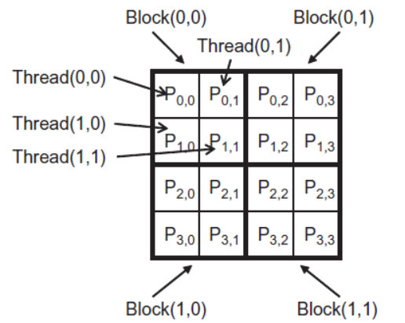
Work for Block (0,0) Thread(0,0)
At last:
Col = 0
Col = 1
Thread(0,0) in block(0,0) 成功计算了矩阵M的第0行和矩阵N的第0列的内积，计算结果保存在P_{0,0}.
After the loop, the thread writes P[Row*Width+Col],
which is P[0], the 1D equivalent of P_{0,0}.
N_{0,0}
N_{0,1}
N_{0,2}
N_{0,3}
N_{1,0}
N_{1,1}
N_{1,2}
N_{1,3}
N_{2,0}
N_{2,1}
N_{2,2}
N_{2,3}
N_{3,0}
N_{3,1}
N_{3,2}
N_{3,3}
Row = 0
M_{0,0}
M_{0,1}
M_{0,2}
M_{0,3}
P_{0,0}
P_{0,1}
P_{0,2}
P_{0,3}
Row = 1
M_{1,0}
M_{1,1}
M_{1,2}
M_{1,3}
P_{1,0}
P_{1,1}
P_{1,2}
P_{1,3}
M_{2,0}
M_{2,1}
M_{2,2}
M_{2,3}
P_{2,0}
P_{2,1}
P_{2,2}
P_{2,3}
M_{3,0}
M_{3,1}
M_{3,2}
M_{3,3}
P_{3,0}
P_{3,1}
P_{3,2}
P_{3,3}

Slide 18
Work for Block (0,1)
Col = 2
Col = 3
N_{0,0}
N_{0,1}
N_{0,2}
N_{0,3}
Col = 1 * 2 + threadIdx.x
Row = 0 * 2 + threadIdx.y
N_{1,0}
N_{1,1}
N_{1,2}
N_{1,3}
N_{2,0}
N_{2,1}
N_{2,2}
N_{2,3}
blockIdx.x
blockIdx.y
N_{3,0}
N_{3,1}
N_{2,3}
N_{3,3}
Row = 0
M_{0,0}
M_{0,1}
M_{0,2}
M_{0,3}
P_{0,0}
P_{0,1}
P_{0,2}
P_{0,3}
Row = 1
M_{1,0}
M_{1,1}
M_{1,2}
M_{1,3}
P_{0,1}
P_{1,1}
P_{1,2}
P_{1,3}
M_{2,0}
M_{2,1}
M_{2,2}
M_{2,3}
P_{2,0}
P_{2,1}
P_{2,2}
P_{2,3}
M_{3,0}
M_{3,1}
M_{3,2}
M_{3,3}
P_{3,0}
P_{3,1}
P_{3,2}
P_{3,3}

Slide 19
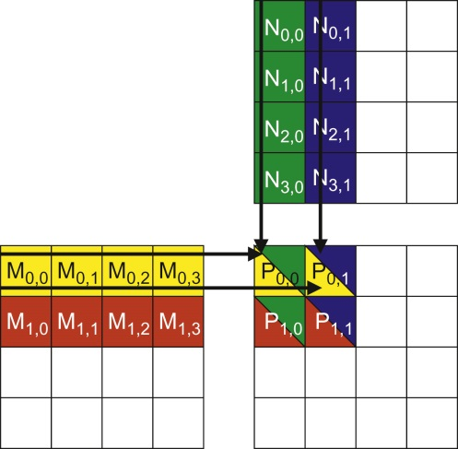
Walk through the for loop
for (int k = 0; k < Width; ++k)
Pvalue += d_M[Row*Width+k] * d_N[k*Width+Col];
2 global memory access for:
One floating point multiplication
One floating point addition
Compute-to-global-memory-access ratio is 1
Result in less than 2% utilization
of the peak execution speed
一个线程块的矩阵乘法操作。

Slide 20
在一个内存带宽为150 GB/s的设备上，性能表现如何呢？
所有线程都访问全局内存以获取其输入矩阵元素。
每次浮点乘加运算需要两次内存访问（8字节）
4B/s 内存带宽/FLOPS
150 GB/s的内存带宽限制了代码的性能为37.5 GFLOPS
实际代码的运行速度约为25GFLOPS
需要大幅减少内存访问次数，才能更接近超过1,000 GFLOPS的峰值性能
Grid
Block (0, 0)
Block (1, 0)
Shared Memory
Shared Memory
Registers
Registers
Registers
Registers
Thread (0, 0)
Thread (1, 0)
Thread (0, 0)
Thread (1, 0)
Host
Global Memory
Constant Memory

Slide 21
Content
Importance of Memory Access Efficiency
--Matrix Multiplication
Memory Types Overview
Tiling for reduced memory traffic
--Matrix Multiplication using Shared Memory

Slide 22
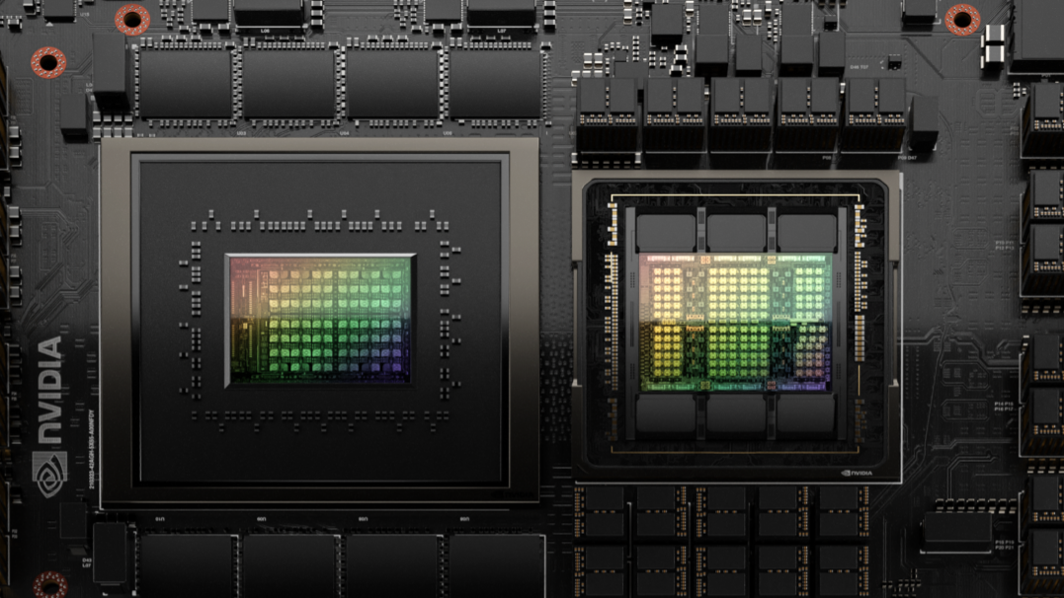
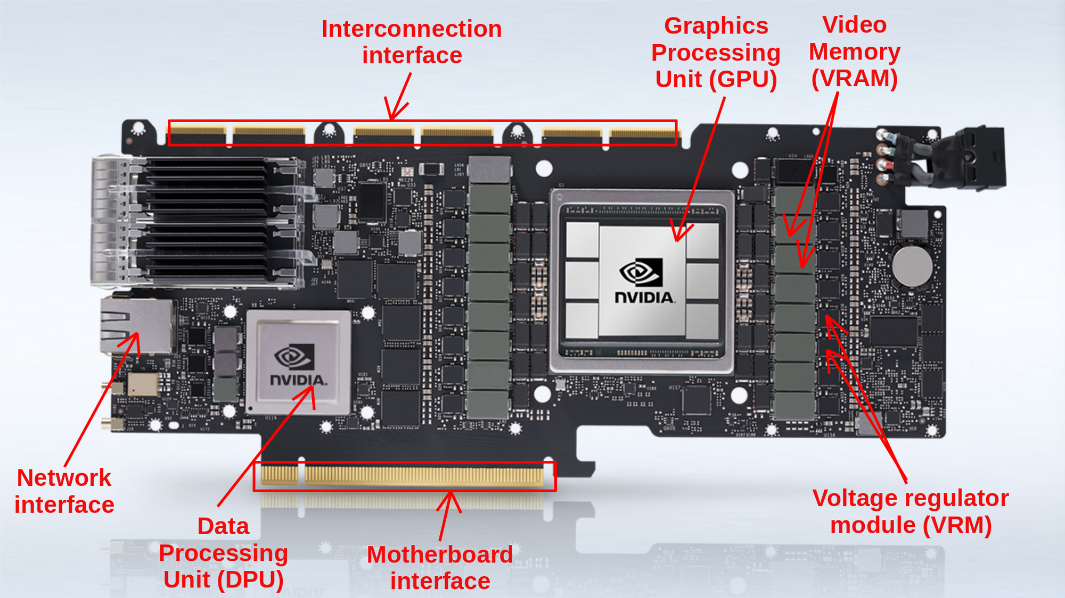
CUDA Memories
Grace-hopper
Notes:
Global, constant, and texture memory spaces are persistent across kernels called by the same application.

Slide 23
Programmer View of CUDA Memories
Host code can：
Transfer data to/from per grid global and constant memories
Device code can:
Read/write per-thread
registers
(~1 cycle)
Read/write per-block
shared memory
(~5 cycles)
Read/write per-grid
global memory
(~500 cycles)
Read/only per-grid
constant memory
(~5 cycles with caching)
Grid
Block (0, 0)
Block (1, 0)
Shared Memory
Shared Memory
Registers
Registers
Registers
Registers
Thread (0, 0)
Thread (1, 0)
Thread (0, 0)
Thread (1, 0)
Host
Global Memory
Constant Memory
Notes:
Global, constant, and texture memory spaces are persistent across kernels called by the same application.

Slide 24
The Von-Neumann Model
Memory
I/O
Global Memory：
Off-chip
意味着较长的访问延迟和相对较低的访问带宽。
Register File ：
on processor chip
非常短的访问延迟和十分高的访问带宽
Processing Unit
Reg
File
ALU
Control Unit
PC
IR
Notes:
Insert von-neumann schematic here

Slide 25
Going back to the program
每条指令都需要从内存中获取、解码，然后执行
解码阶段通常会访问寄存器文件。
指令分为三种类型：
运算指令、数据传输指令和程序控制流指令:
Operate, Data transfer, and Program Control Flow.
一个指令周期的例子如下:
Fetch | Decode | Execute | Memory
Notes:
victoria@samsung.com

Slide 26
Operate Instructions
在大多数现代处理器中，算术指令具有“内置”的寄存器操作（operands）。
运算指令的一个例子 :
fadd r1, r2, r3
当算术指令的操作（operand）位于寄存器中时，无需额外指令即可将操作的值提供给算术逻辑单元（ALU）。
Register numbers

Slide 27
Memory Access Instructions
如果指令的操作数值位于全局内存 global memory:
load r2, r4, offset
fadd r1, r2, r3
从全局内存加载数据的成本远远高于从寄存器加载：
- 更多的时钟周期；
- 更多的能耗。

Slide 28
Registers vs Memory
Registers are “free”
无需额外的内存访问指令，
能耗低，
使用非常快速，
但数量有限。
Memory is expensive：
访问慢 (slow)
but very large
Notes:
Desk analogy: books on your desk are registers. The library is memory

Slide 29
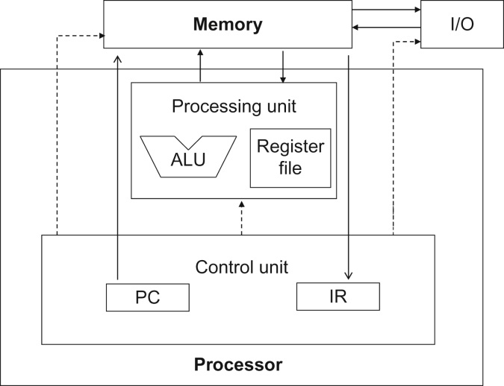
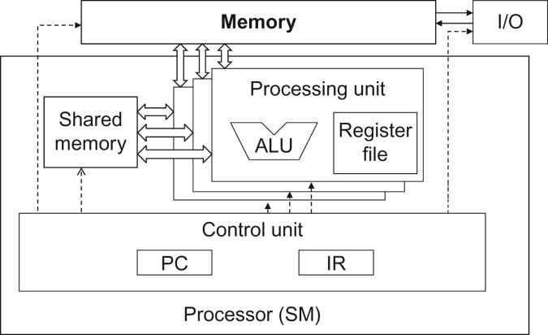
Registers vs Memory
von Neumann model
CUDA device SM
三类存储的区别 registers, shared memory, global memory:
位置 Location
延迟 Latency
带宽 Bandwidth
访问范围 Access scope

Slide 30
CUDA Variable Type Qualifiers
Variable declaration | Memory | Scope | Lifetime
Automatic variables int LocalVar; | Register* | thread | kernel
__device__ __shared__ int SharedVar; | shared | block | Kernel
__device__ int GlobalVar; | global | grid | application
__device__ __constant__ int ConstantVar; | constant | grid | application
__device__ is optional when used with __shared__, or __constant__
Automatic variables
前面没有修饰符的变量，存储在寄存器中，
每个线程都有一个私有副本（注意不要超出容量限制）。
*Except per-thread arrays that reside in global memory

Slide 31
CUDA Variable Type Qualifiers
Variable declaration | Memory | Scope | Lifetime
Automatic variables int LocalVar; | Register* | thread | kernel
__device__ __shared__ int SharedVar; | shared | block | Kernel
__device__ int GlobalVar; | global | grid | application
__device__ __constant__ int ConstantVar; | constant | grid | application
Shared variables
每个block有一个私有副本，在一个block中的所有thread间共享，为块中的线程提供高效的协作方式
原本存储在全局内存，在kernel执行时频繁使用的变量，放入共享内存，提高执行效率.

Slide 32
CUDA Variable Type Qualifiers
Variable declaration | Memory | Scope | Lifetime
Automatic variables int LocalVar; | Register* | thread | kernel
__device__ __shared__ int SharedVar; | shared | block | Kernel
__device__ int GlobalVar; | global | grid | application
__device__ __constant__ int ConstantVar; | constant | grid | application
Global variables
速度较慢，
但近期的设备通过使用缓存来改善延迟和吞吐量。
可以用于跨块的线程协作，
或者从一个内核调用向另一个内核调用传递信息。

Slide 33
CUDA Variable Type Qualifiers
Variable declaration | Memory | Scope | Lifetime
Automatic variables int LocalVar; | Register* | thread | kernel
__device__ __shared__ int SharedVar; | shared | block | Kernel
__device__ int GlobalVar; | global | grid | application
__device__ __constant__ int ConstantVar; | constant | grid | application
Constant variables
存储在全局内存中，但为了高效访问而被缓存。
必须定义在任何函数体之外。
所有网格中的所有线程看到相同的版本。
通常用于为内核函数提供输入值的变量。

Slide 34
Content
Importance of Memory Access Efficiency
--Matrix Multiplication
Memory Types Overview
Tiling for reduced memory traffic
--Matrix Multiplication using Shared Memory

Slide 35

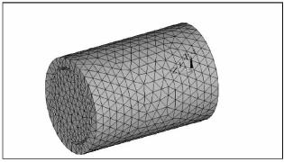
A Common Programming Strategy
CUDA设备内存的权衡：
全局内存容量大但速度慢，
共享内存容量小但速度快。
一种常见策略:
将数据划分为称为“瓦片”（tile）的子集
以便每个瓦片都能放入共享内存中.

Slide 36
A Common Programming Strategy
将输入数据划分为瓦片以利用快速的共享内存.
通过以下方式处理每个数据子集：
使用多个线程从全局内存加载子集到共享内存，利用内存级并行性；
在共享内存中的子集上执行计算，每个线程可以高效地多次访问共享数据元素；
将计算结果从共享内存复制到全局内存；
继续下一个瓦片

Slide 37
Shared Memory Blocking Basic Idea
in
Global Memory
Thread 1
Thread 2
…
Global Memory
in
On-chip Memory
Thread 1
Thread 2
…

Slide 38
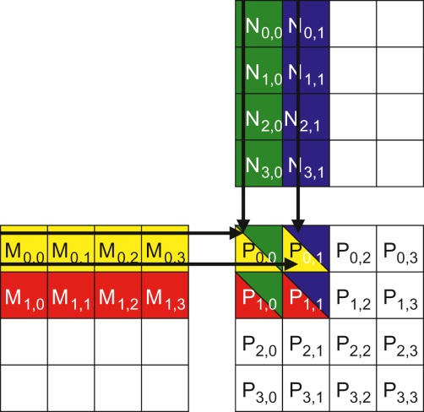
The small example
Assumes four 2× 2 blocks to compute the P matrix.
For brevity:
M[y*Width+ x], N[y*Width + x], P[y*Width+ x]
as
My,x Ny,x Py,x.
4 threads of block(0,0) compute for P0,0, P0,1, P1,0, and P1,1.
Thread(0,0) reads M0,0 and N0,0, followed by M0,1 and N1,0,…

Slide 39
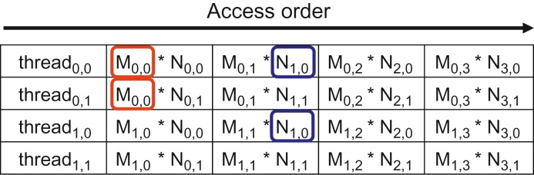
The small example
Memory access of Block(0,0)
每个M和N的元素都被读取了两次。
全局内存流量的潜在减少量与所使用的块的维度成正比。
如果使用 16x16 blocks, 数据交通量减少到_____ ?
Compute-to-global-memory-access Ratio increased from 1 to 16,
peak performance approach 600GFLOPS.

Slide 40
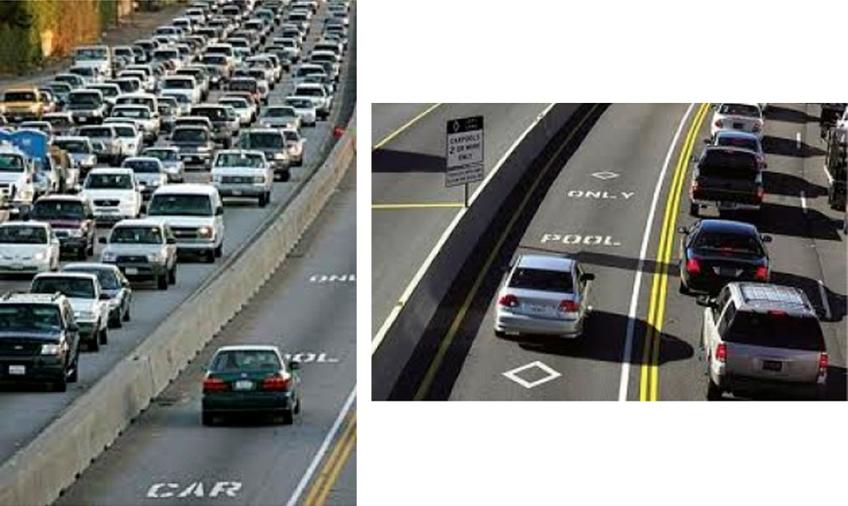
类比：Tiled algorithm are highly similar to carpooling arrangement.
With extra effort.

Slide 41
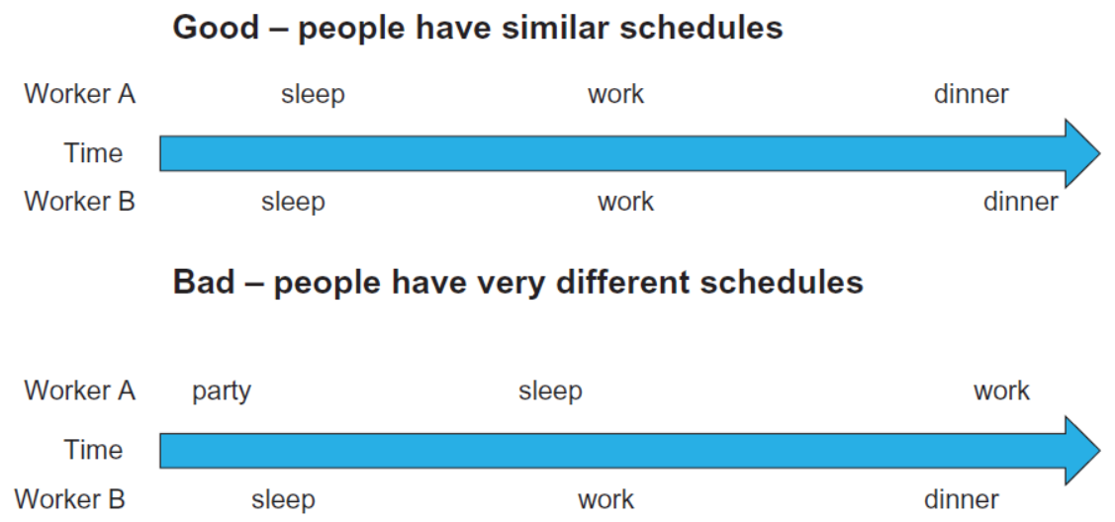
Carpooling requires synchronization

Slide 42
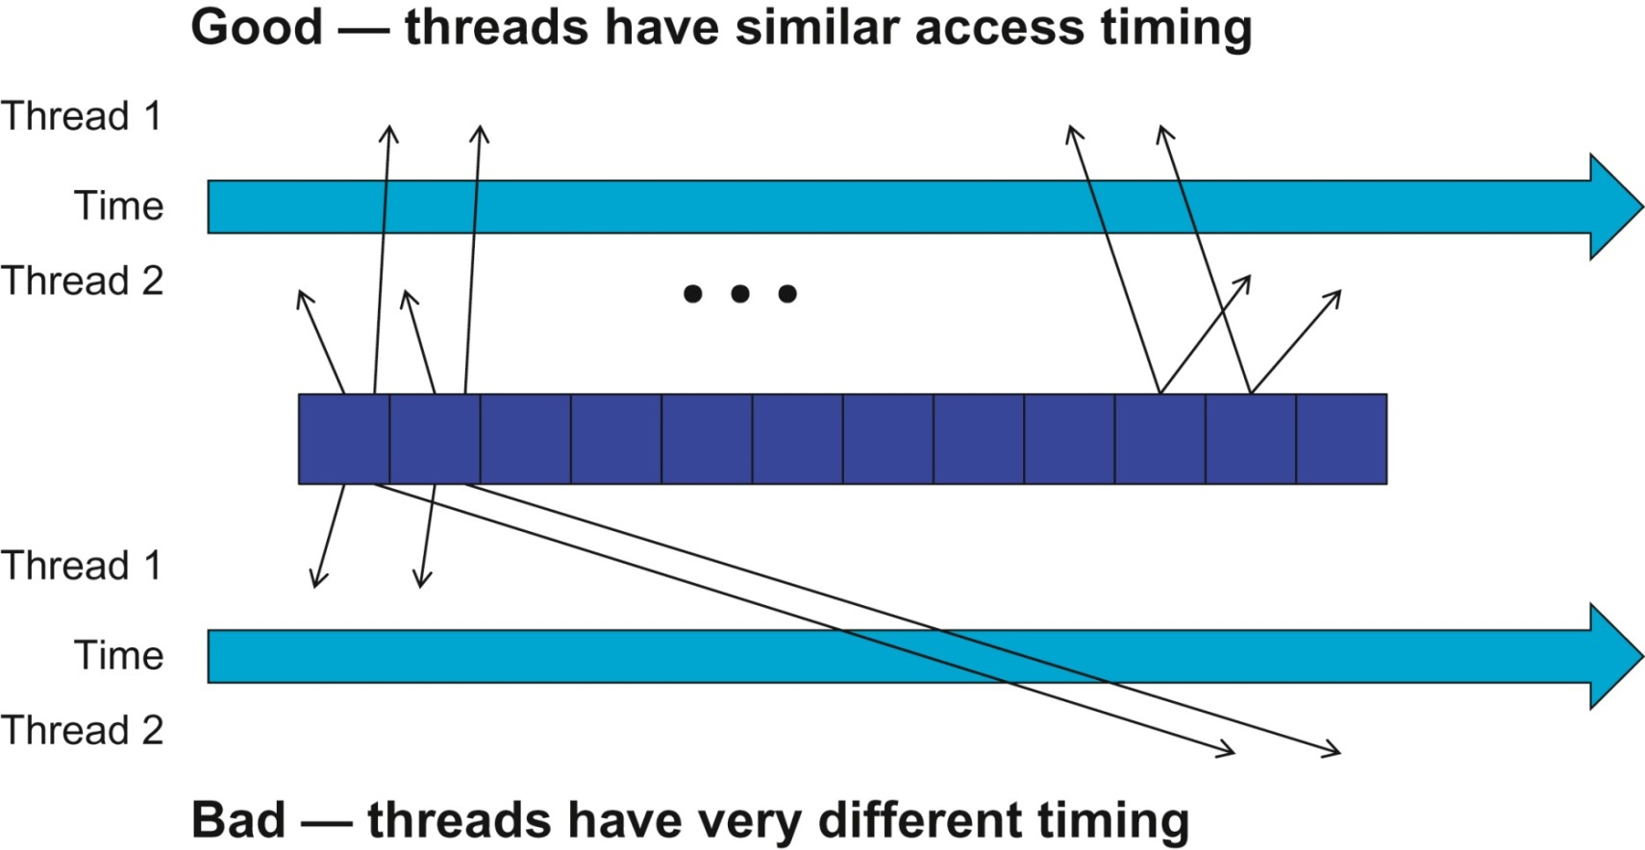
瓦片算法需要线程之间的同步。

Slide 43
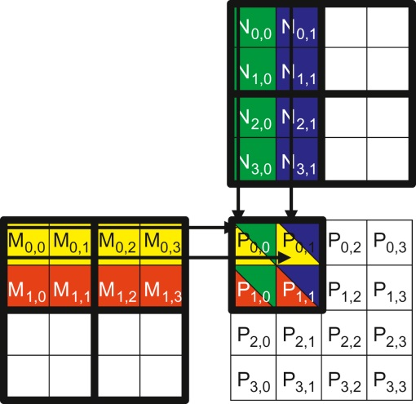
The small example
将M和N划分为瓦片以利用快速但容量小的共享内存。
在点积运算之前，所有线程协作，加载M和N的子集。
将M 和 N 划分为 2 × 2 瓦片:
每积个线程执行的点乘运算现在分为多个阶段phases.
每个phase中, 一个块中的所有线程协作将M的一个瓦片和N的一个瓦片加载到共享内存中。
线程块中的每个线程加载一个M元素和一个N元素。

Slide 44
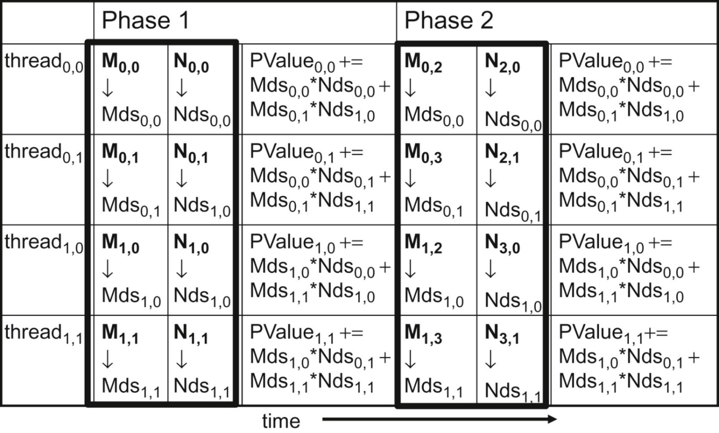
The small example
Execution phases of a tiled matrix multiplication.
用于存储M元素的共享内存数组定义为Mds
locality
共享内存中的每个值都被使用两次; e.g. M1,1

Slide 45
Tiled Matrix Multiplication Kernel
__global__ void MatrixMulKernel(float* M, float* N, float* P, int Width){
1. __shared__ float subTileM[TILE_WIDTH][TILE_WIDTH];
2. __shared__ float subTileN[TILE_WIDTH][TILE_WIDTH];
3. int bx = blockIdx.x; int by = blockIdx.y;
4. int tx = threadIdx.x; int ty = threadIdx.y;
// Identify the row and column of the P element to work on
5. int Row = by * TILE_WIDTH + ty;
6. int Col = bx * TILE_WIDTH + tx;
7. float Pvalue = 0;
// Loop over the M and N tiles required to compute the P element
8. for (int m = 0; m < Width/TILE_WIDTH; ++m) {
// Collaborative loading of M and N tiles into shared memory
9. subTileM[ty][tx] = M[Row*Width + m*TILE_WIDTH+tx];
subTileN[ty][tx] = N[(m*TILE_WIDTH+ty)*Width+Col];
__syncthreads();
12. for (int k = 0; k < TILE_WIDTH; ++k)
13. Pvalue += subTileM[ty][k] * subTileN[k][tx];
14. __syncthreads();
15. }
16. P[Row*Width+Col] = Pvalue;
}

Slide 46
Loading an Input Tile 0
bx
0
1
2
tx
0
TILE_WIDTH-1
1
2
Accessing tile 0 2D indexing:
M[Row][tx]
N[ty][Col]
N
TILE_WIDTH
Width
TILE_WIDTH
M
P
0
0
1
ty
2
Width
by
1
TILE_WIDTHE
TILE_WIDTH-1
TILE_WIDTH
TILE_WIDTH
TILE_WIDTH
2
Width
Width

Slide 47
Loading an Input Tile 1
bx
0
1
2
tx
0
TILE_WIDTH-1
1
2
Accessing tile 1 in 2D indexing:
M[Row][1*TILE_WIDTH+tx]
N[1*TILE_WIDTH+ty][Col]
N
TILE_WIDTH
WIDTH
TILE_WIDTH
M
P
0
0
1
ty
2
WIDTH
by
1
TILE_WIDTHE
TILE_WIDTH-1
TILE_WIDTH
TILE_WIDTH
TILE_WIDTH
2
WIDTH
WIDTH

Slide 48
Loading an Input Tile m
bx
0
1
2
tx
然而，需要注意的是，M和N是动态分配的，只能使用一维索引：
M[Row][m*TILE_WIDTH+tx]
M[Row*Width + m*TILE_WIDTH + tx]
N[m*TILE_WIDTH+ty][Col]
N[(m*TILE_WIDTH+ty) * Width + Col]
0
TILE_WIDTH-1
1
2
N
TILE_WIDTH
m
WIDTH
TILE_WIDTH
M
P
0
m
0
1
ty
2
WIDTH
by
1
TILE_WIDTHE
TILE_WIDTH-1
TILE_WIDTH
TILE_WIDTH
TILE_WIDTH
2
WIDTH
WIDTH

Slide 49
Barrier Synchronization
瓦片方法需要块内线程同步 :
__syncthreads()
同一块中的所有线程都必须在任何线程继续执行之前到达__syncthreads()。
它最适合用于协调瓦片算法，
以确保瓦片的所有元素都已加载，
以确保瓦片的所有元素都已使用。

Slide 50
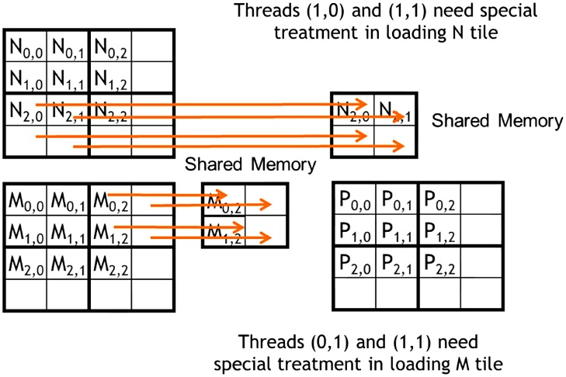
Boundary Checks
3x3 matrix
What’s the problem?
Loading input matrix elements that are close to the edge– phase 1 of Block0,0.

Slide 51
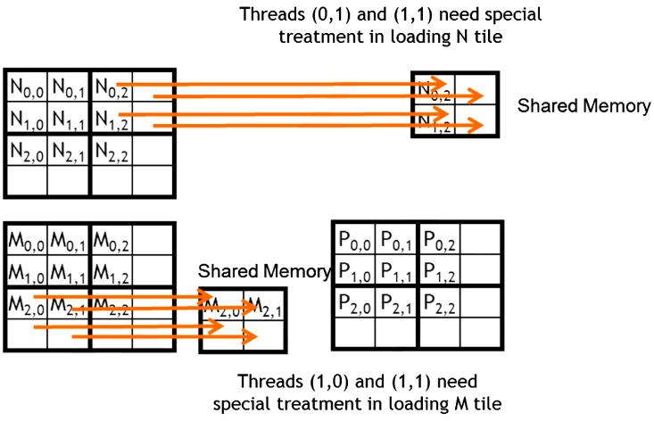
Boundary Checks
3x3 matrix
FIGURE 4.19: Loading input elements during phase 0 of block1,0.

Slide 52
Boundary Checks
// Loop over the M and N tiles required to compute P element
8. for (int ph = 0; ph < ceil(Width/(float)TILE_WIDTH); ++ph) {
// Collaborative loading of M and N tiles into shared memory
9. if ((Row< Width) && (ph*TILE_WIDTH+tx)< Width)
Mds[ty][tx] = M[Row*Width + ph*TILE_WIDTH + tx];
10. if ((ph*TILE_WIDTH+ty)<Width && Col<Width)
Nds[ty][tx] = N[(ph*TILE_WIDTH + ty)*Width + Col];
11. __syncthreads();
12. for (int k = 0; k < TILE_WIDTH; ++k) {
13. Pvalue += Mds[ty][k] * Nds[k][tx];
}
14. __syncthreads();
}
15. if ((Row<Width) && (Col<Width)) P[Row*Width + Col] = Pvalue;
带有边界条件检查的分块矩阵乘法内核。

Slide 53
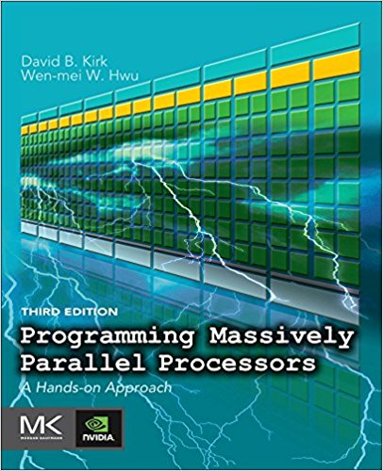
Reference
CUDA C Programming Guide,
https://docs.nvidia.com/cuda/cuda-c-programming-guide/index.html
Programming Massively Parallel Processors,
A Hands-on Approach
Third Edition
Chapter 4

